Slide 1
Graph

Slide 2
What is a Graph?
A graph G = (V,E) is composed of:
V: set of vertices
E: set of edges or arcs connecting the vertices in V
An edge e = (u,v) is a pair of vertices belonging to E
weight or cost
Example:
a
b
V= {a,b,c,d,e}
E= {(a,b),(a,c),(a,d),
(b,e),(c,d),(c,e),
(d,e)}
c
d
e

Slide 3
Directed vs. Undirected Graph
An undirected graph is one in which the pair of vertices in a edge is unordered, (v0, v1) = (v1,v0)
A directed graph is one in which each edge is a directed pair of vertices, <v0, v1> != <v1,v0>
tail
head

Slide 4
Applications
CS16
electronic circuits
networks (roads, flights, communications)
JFK
LAX
LAX
TLS
HNL
DFW

Slide 5
Terminology: Adjacent and Incident
If (v0, v1) is an edge in an undirected graph,
  v0 and v1 are adjacent
  The edge (v0, v1) is incident on vertices v0 and v1
If <v0, v1> is an edge in a directed graph
  v0 is adjacent to v1, and v1 is adjacent from v0
  The edge <v0, v1> is incident on v0 and v1

Slide 6
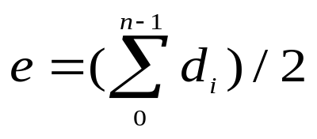
Terminology: Degree of a Vertex
The degree of a vertex is the number of edges incident to that vertex
For directed graph,
  the in-degree of a vertex v is the number of edges
  that have v as the head
  the out-degree of a vertex v is the number of edges
  that have v as the tail
  if di is the degree of a vertex i in a graph G with n vertices and e edges, the number of edges is

Slide 7
Examples
0
3
2
0
1
2
3
3
3
1
2
3
3
4
5
6
1
1
1
3
G1
1
G2
3
0
in:1, out: 1
directed graph
in-degree
out-degree
1
in: 1, out: 2
2
in: 1, out: 0
G3

Slide 8
Path
Path: sequence of vertices v₁,v₂,. . .v_{k} such that consecutive vertices v_{i} and v_{i+1} are adjacent.
Length of the path: length of the shortest path between the vertices
Loop: A loop (also called a self-loop or a "buckle") is an edge that connects a vertex to itself. A simple graph contains no loops.
a
b
a
b
c
c
d
e
d
e
a b e d c
b e d c

Slide 9
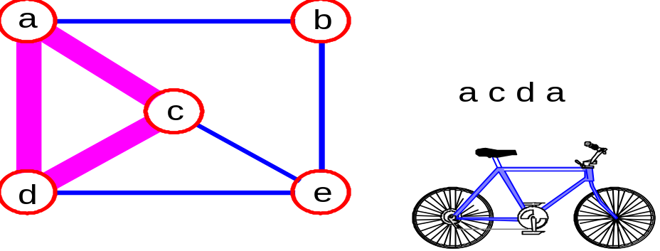
Contd.
Simple path: no repeated vertices
Cycle: simple path, except that the last vertex is the same as the first vertex
DAG (Directed Acyclic Graph) – A directed graph with no cycles
a
b
b e c
c
d
e

Slide 10
Contd.
connected graph: any two vertices are connected by some path in undirected graph
subgraph: subset of vertices and edges forming a graph
.

Slide 11
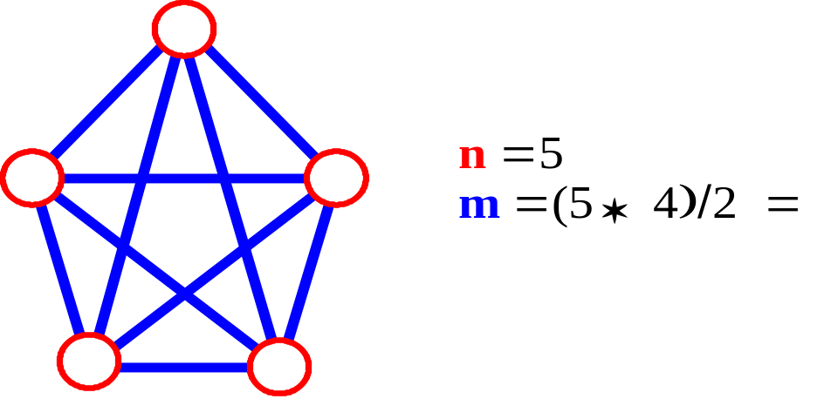
Connectivity
Let n = no. of vertices, and m = no. of edges
A complete graph is a graph in which there is an edge between every pair of vertices
How many total edges in a complete graph?
  Each of the n vertices is incident to n-1 edges, however, we would have counted each edge twice! Therefore, intuitively, m = n(n -1)/2.
Therefore, if a graph is not complete, m < n(n -1)/2
Strongly connected
  An undirected graph is connected if there is a path from every vertex to every other vertex. A directed graph with this property is said to be strongly connected.
Weakly connected
  If the directed graph is not strongly connected, but the underlying graph ( without direction) is connected, then the graph is said to be weakly connected.

Slide 12
Graph Representations
Adjacency Matrix
Adjacency Lists

Slide 13
Adjacency Matrix
Let G=(V,E) be a graph with n vertices.
The adjacency matrix of G is a two-dimensional
n by n array, say adj_mat
If the edge (vi, vj) is in E(G), adj_mat[i][j]=1
If there is no such edge in E(G), adj_mat[i][j]=0
The adjacency matrix for an undirected graph is symmetric; the adjacency matrix for a digraph
need not be symmetric

Slide 14
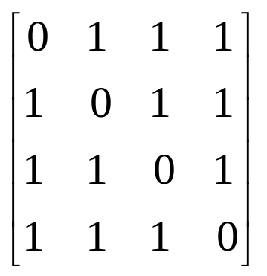
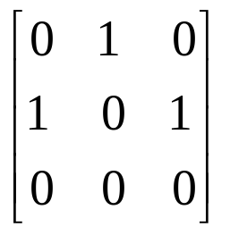
Examples for Adjacency Matrix
0
0
1
2
3
1
2
G1
G2

Slide 15
Adjacency Lists
Each row in adjacency matrix is represented as an adjacency list
#define MAX_VERTICES 50
typedef struct node *node_pointer;
typedef struct node
{
int vertex;
struct node *link;
};
node_pointer graph[MAX_VERTICES];

Slide 16
Examples for Adjacency Lists
0
0
1
2
0
1
2
1
0
2
1
3
0
1
2
3
1
2
3
G2
2
0
2
3
0
1
3
0
1
2
G1

